Slide 1

Mutual Fund Analytics Platform
Capstone Project – Bluestock Fintech Pvt. Ltd.
Submitted by: Anushka Das

Slide 2
Problem Statement & Objectives
Problem Statement
Objectives
Investors struggle to evaluate mutual fund performance.
Risk and return metrics are difficult to interpret.
Data exists across multiple sources.
Need for a unified analytics platform.
Build ETL Pipeline
Perform EDA
Calculate Risk Metrics
Create Dashboards
Investor Analytics
Benchmark Comparison
Advanced Analytics

Slide 3
Data Sources & Project Scale
KPI Cards
Data Sources and Coverage
Metric | Value
Total Datasets | 10
NAV Records | 46,000+
Investor Transactions | 32,000+
Investors | 5,000
Primary Data Sources
• AMFI India • mfapi.in API • Benchmark Indices • Investor Transaction Data • Portfolio Holdings Data
Project Coverage • 40 Mutual Fund Schemes • 10 Asset Management Companies • 12 Indian States • 4+ Years Historical Data • Multiple Benchmark Indices

Slide 4
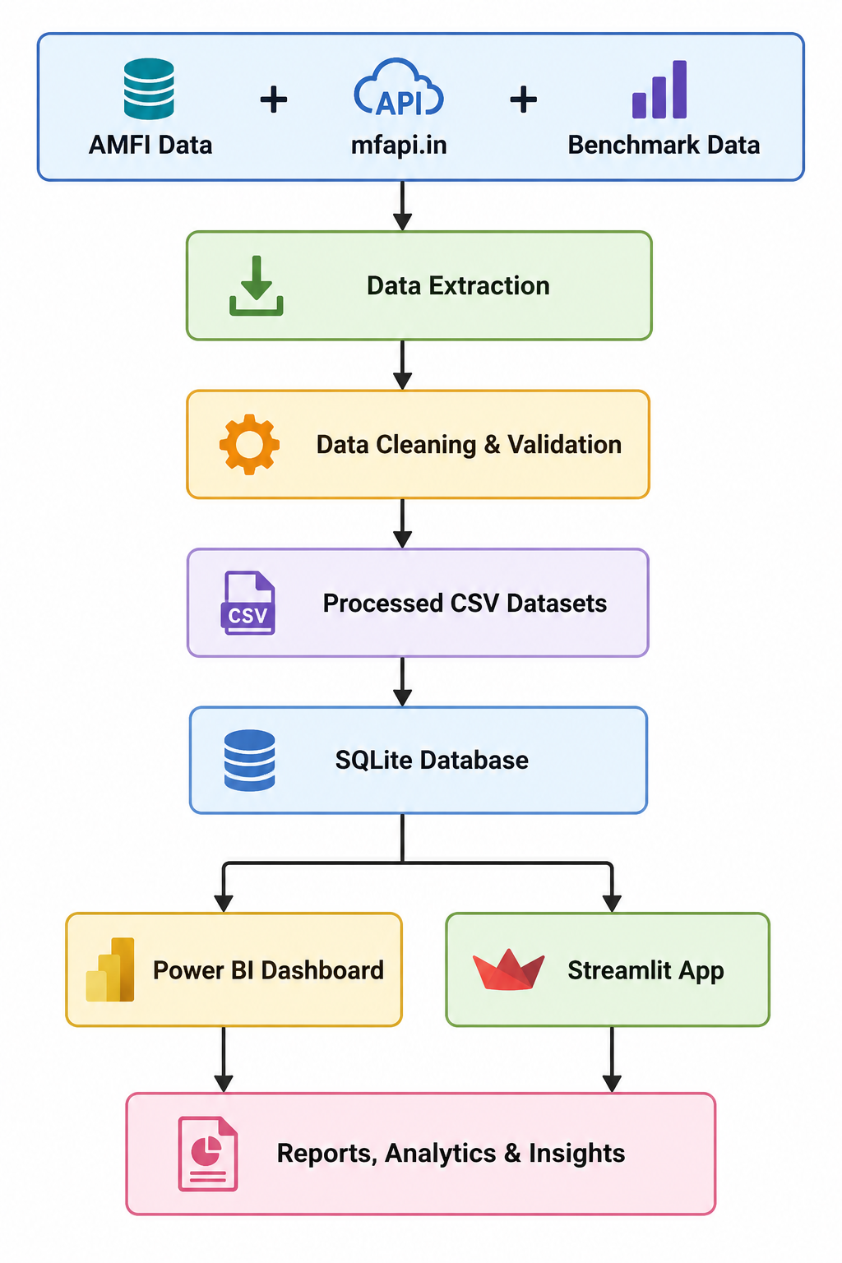
System Architecture & ETL

Slide 5
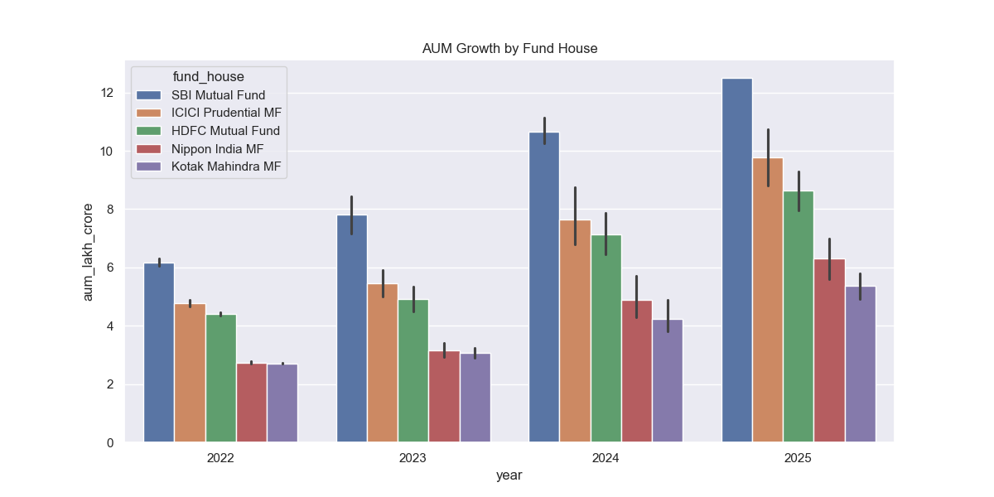
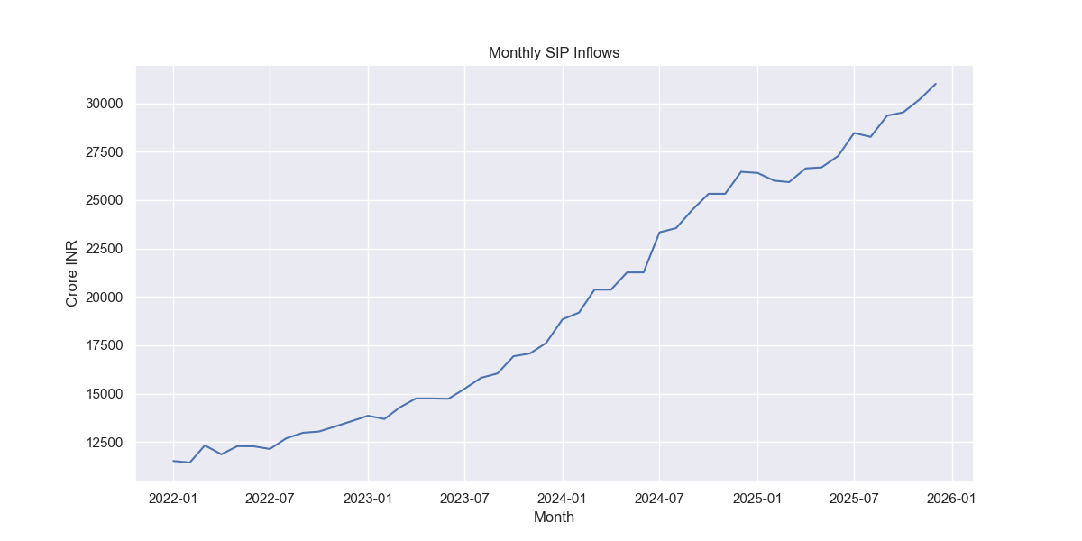
Exploratory Data Analysis (EDA)
• Industry Assets Under Management (AUM) showed consistent growth throughout the analysis period. • Monthly SIP inflows increased significantly, indicating growing retail investor participation. • Mutual fund adoption continued to expand across different investor segments. • Industry growth was supported by sustained capital inflows and increasing investor confidence.
Notes:
"The EDA phase helped identify major industry trends. Assets under Management and SIP contributions both exhibited strong growth patterns, indicating increasing participation in mutual fund investments. These findings established the foundation for subsequent risk analysis and performance evaluation."

Slide 6
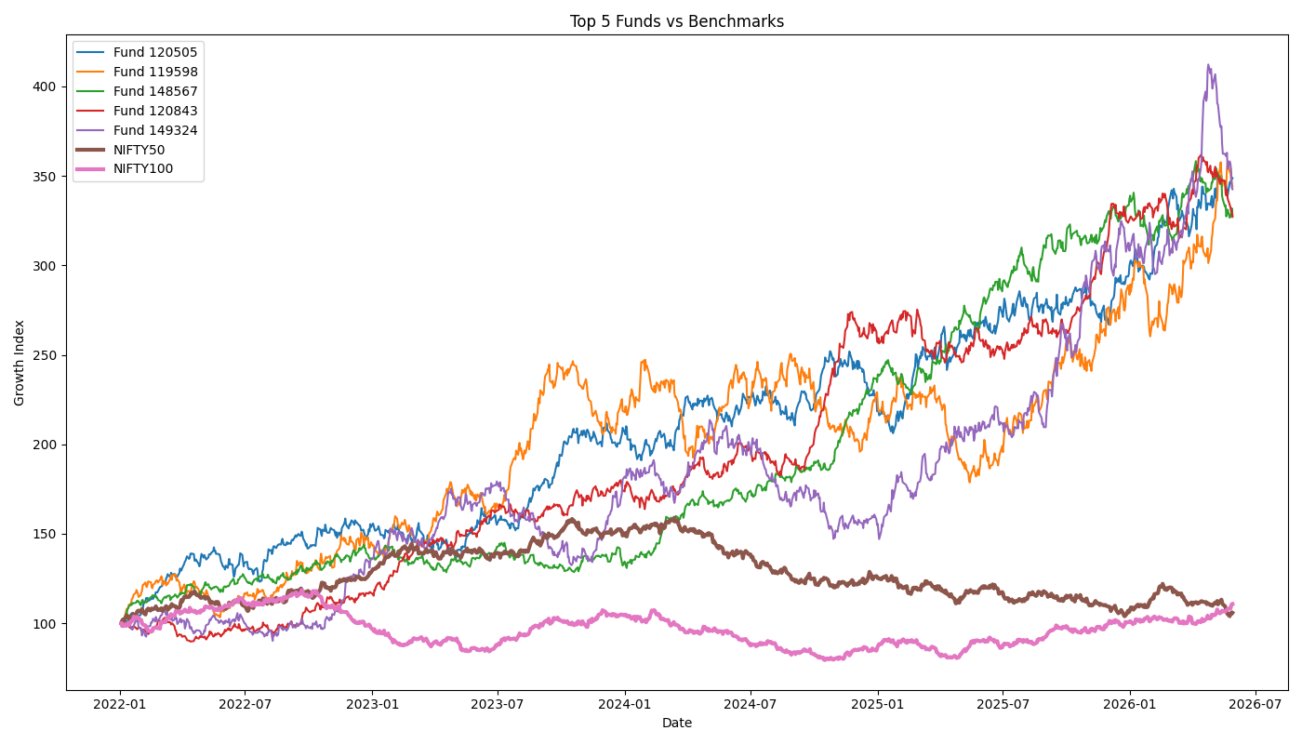
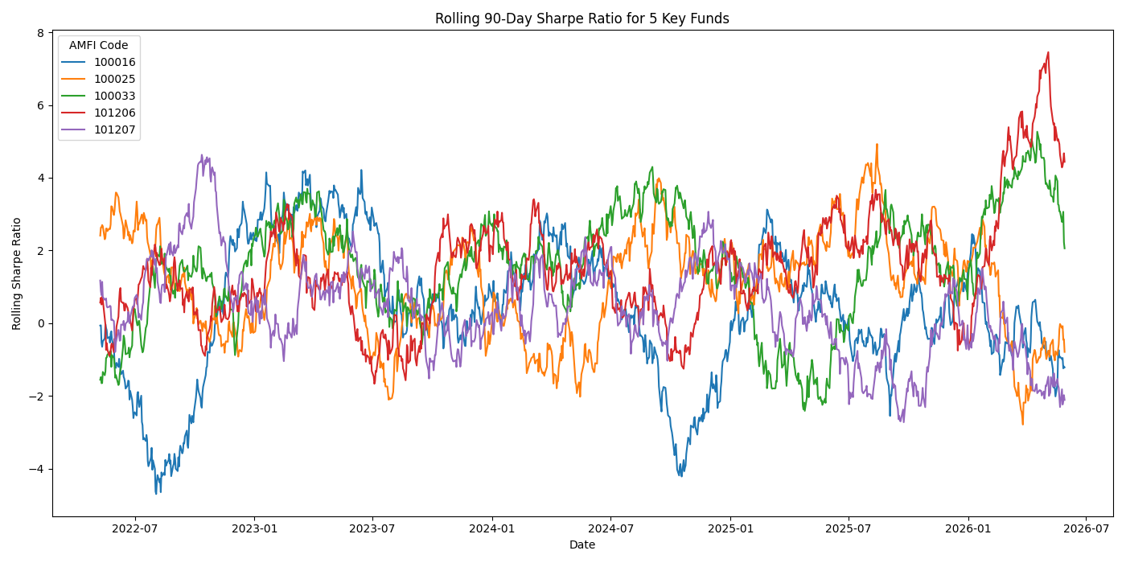
Performance & Risk Analytics
Risk Metrics Used
• Value at Risk (VaR) • Conditional VaR (CVaR) • Rolling Sharpe Ratio • Volatility Analysis
Performance Metrics Used
• CAGR
• Sharpe Ratio
• Sortino Ratio
• Alpha
• Beta
• Maximum Drawdown

Slide 7
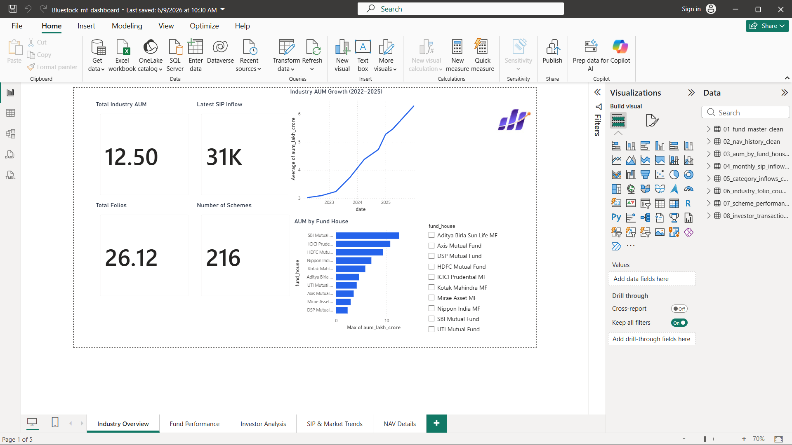
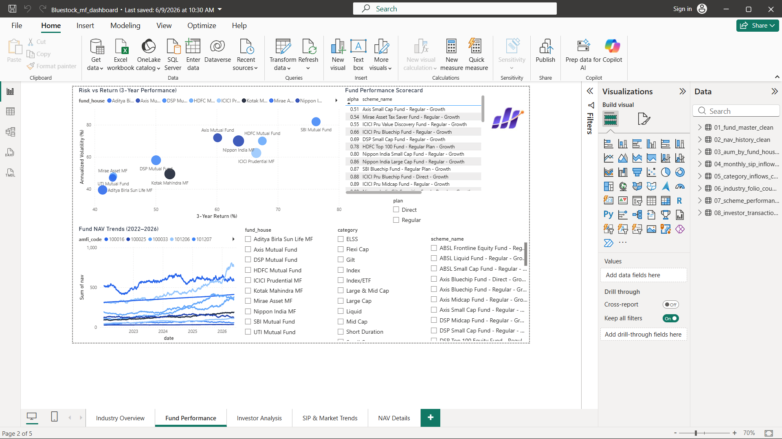
Power BI Dashboard – Industry Overview & Fund Performance
Dashboard Capabilities
✓ Interactive Filters
✓ Fund-Level Analysis
✓ Benchmark Comparison
✓ Trend Visualization
✓ Performance Monitoring
Key Insights
• Industry AUM and SIP inflows continued to show strong growth.
• Fund performance varied significantly across categories.
• Benchmark comparisons helped identify outperforming schemes.
• Interactive visualizations improved accessibility of complex financial metrics.

Slide 8
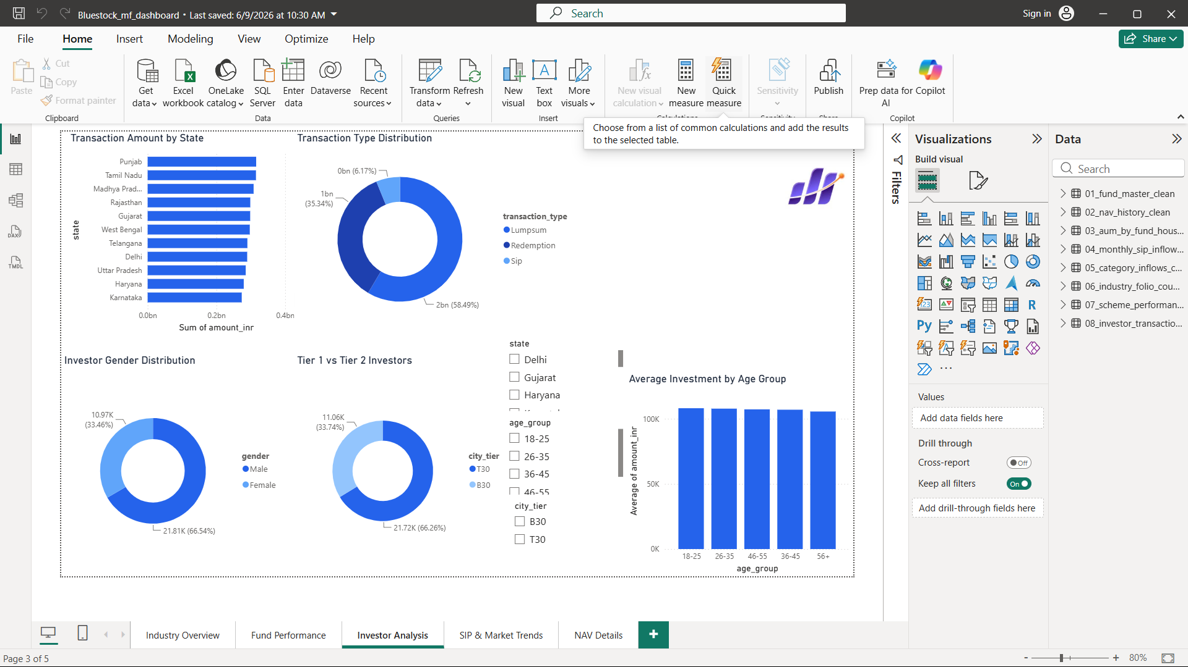
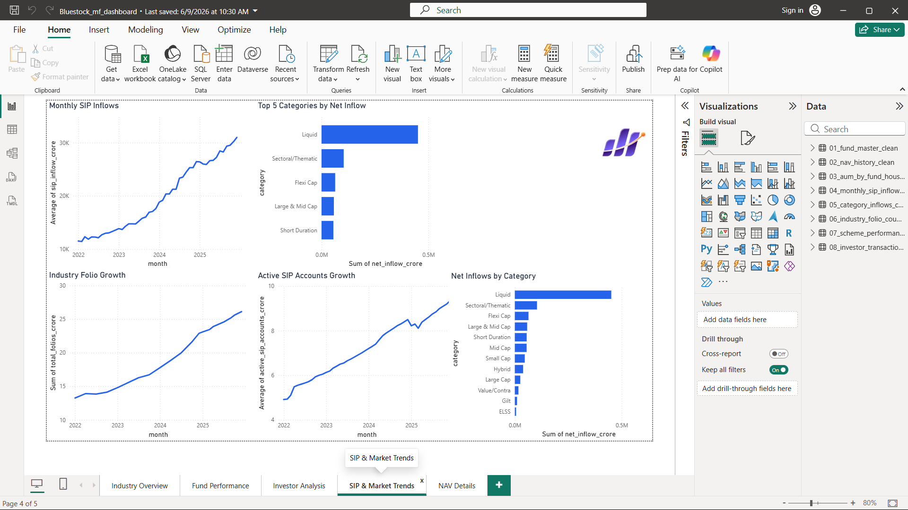
Power BI Dashboard – Investor Analytics & SIP Market Trends
Business Value
• Understand investor behavior
• Track SIP growth trends
• Identify participation patterns
• Support investment decision-making
• Monitor industry expansion
Analytics Covered
• Investor Demographics
• Transaction Analysis
• Income Segmentation
• State-wise Participation
• SIP Behavior Analysis

Slide 9
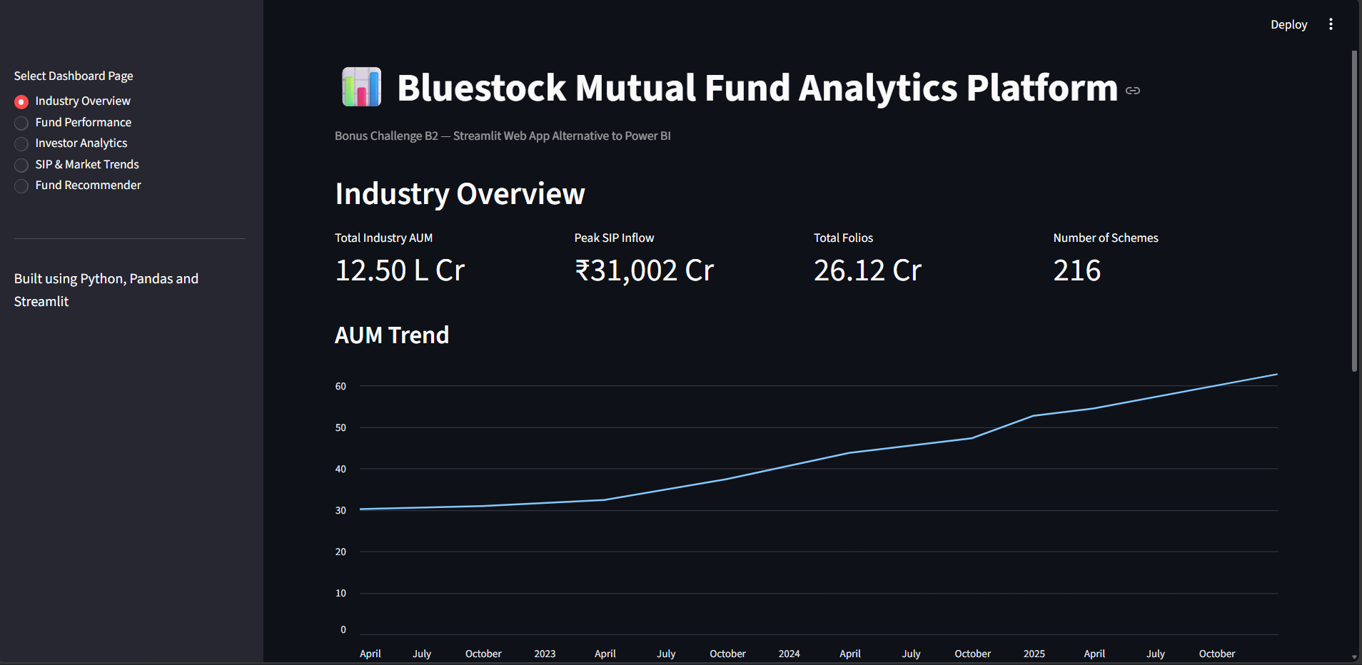
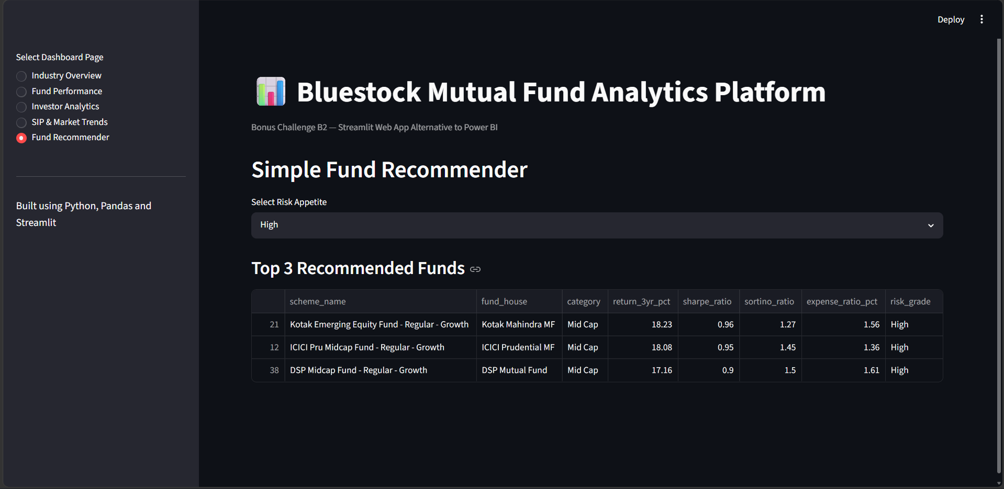
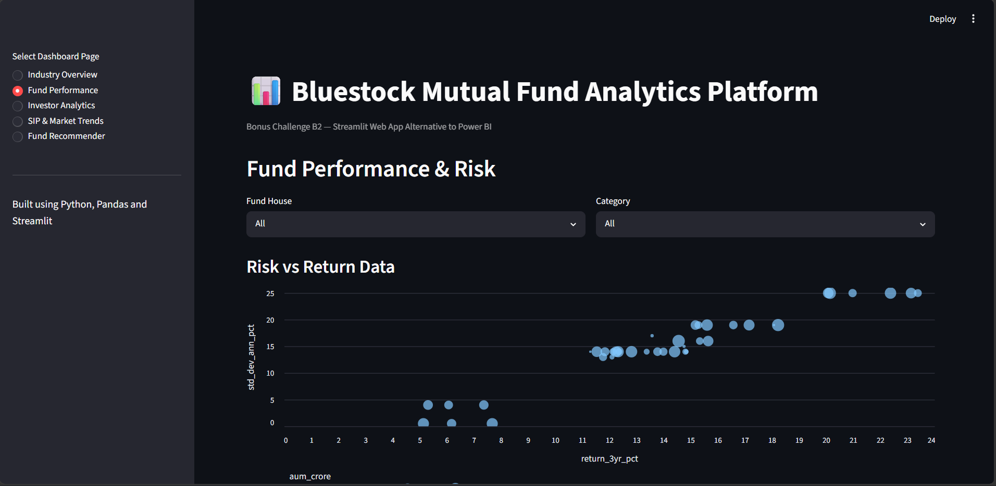
Streamlit Dashboard

Slide 10
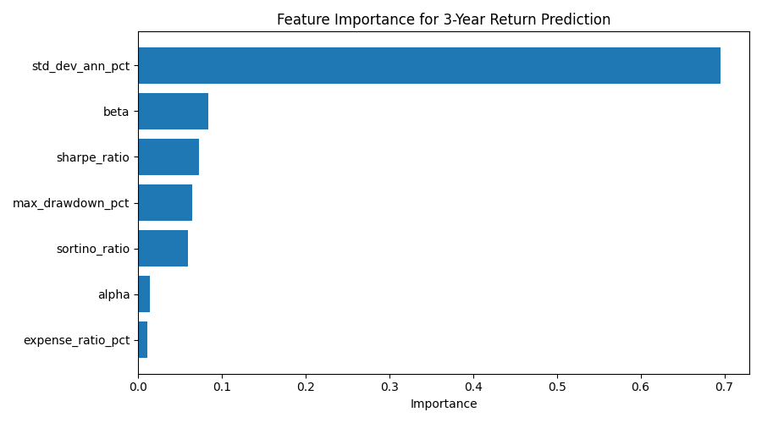
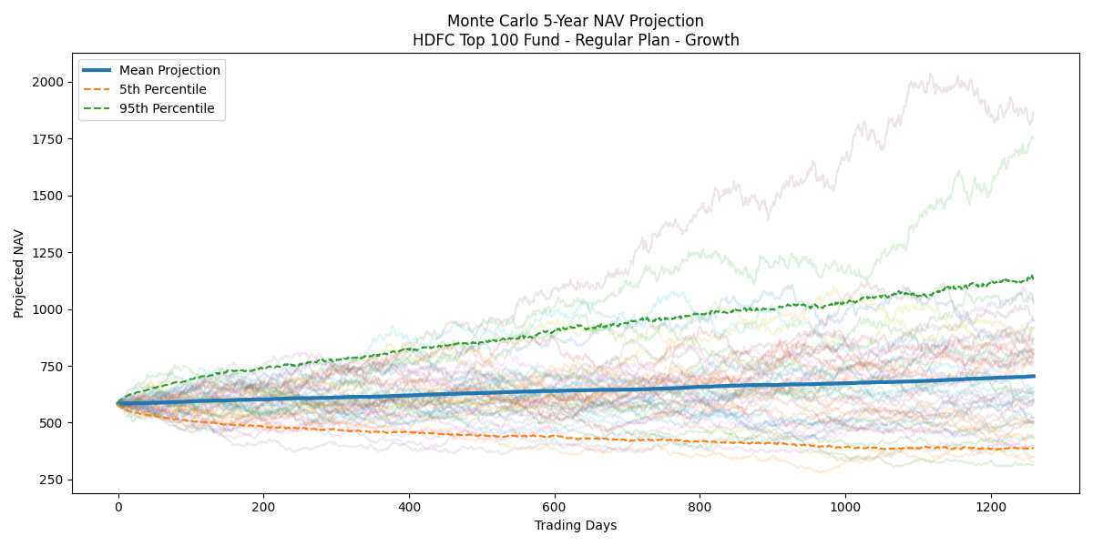
Machine Learning & Forecasting Analytics
Random Forest Feature Importance
5-Year Monte Carlo NAV Forecast
ML Model Performance
R² Score : 0.9058
MAE : 1.07
RMSE : 1.55
Key Results
• Random Forest model used for return prediction.
• Annualized volatility emerged as the most important feature.
• Monte Carlo simulation generated 1,000 future NAV scenarios.
• Forecasting provided confidence intervals for future performance.

Slide 11
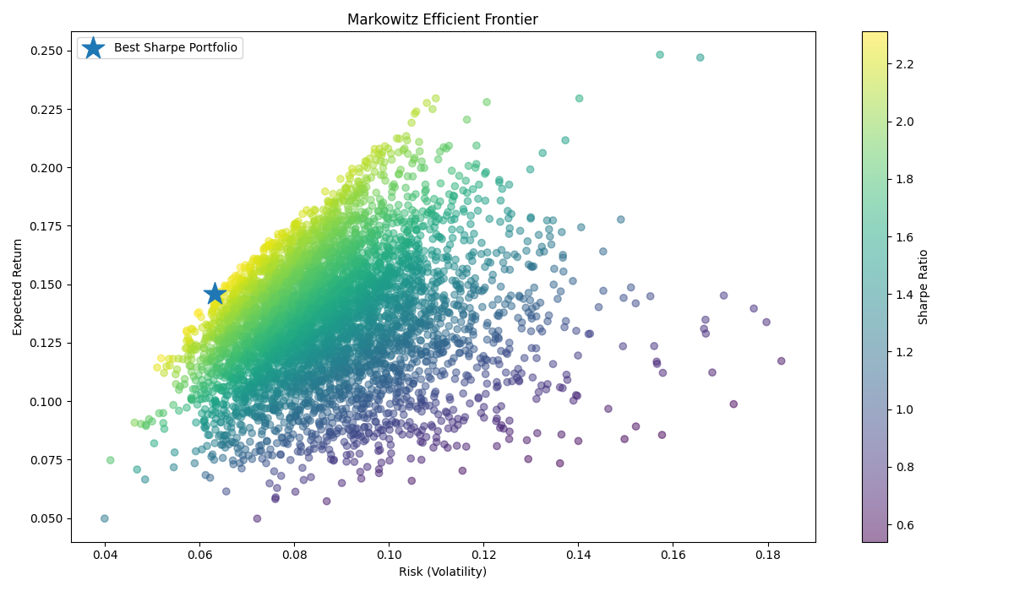
Portfolio Optimization & Key Findings
Markowitz Efficient Frontier
Optimal Portfolio
Expected Return: 14.59%
Risk (Volatility): 6.31%
Sharpe Ratio: 2.31
5,000 Portfolios Simulated
Portfolio Allocation
Fund 100025 → 39.24%
Fund 101206 → 30.62%
Fund 100033 → 20.78%
Fund 101207 → 4.85%
Fund 100016 → 4.51%
Notes:
• Industry AUM and SIP inflows showed strong long-term growth.
• Risk-adjusted performance varied significantly across schemes.
• Volatility was the strongest predictor of future returns.
• Monte Carlo simulation provided useful forecasting scenarios.
• Portfolio diversification improved risk-adjusted returns and reduced concentration risk.

Slide 12
Conclusion & Thank You
Project Summary
Key Achievements
Successfully developed an end-to-end
Mutual Fund Analytics Platform integrating:
✓ Data Engineering
✓ Financial Analytics
✓ Business Intelligence
✓ Machine Learning
✓ Portfolio Optimization
✓ Automated Reporting
• 10 Integrated Datasets
• 46,000+ NAV Records Processed
• 32,000+ Investor Transactions Analyzed
• Power BI Dashboard Developed
• Streamlit Analytics Platform Developed
• ML Model (R² = 0.9058)
• Monte Carlo Forecasting
• Markowitz Portfolio Optimization

